Slide 1
JavaScript Scope, Objects and ‘Complex’ Topics

Slide 2
Key Topics
Function Scope and Callbacks
Object Introduction
The Execution Stack
Recursion

Slide 3
Function Scope and Callbacks

Slide 4
Function Review
A function (subroutine, subprogram) is an isolated set of statements that can be invoked as a batch.
You can pass input values into a function for use, and a function may return a single output value.
After a function is created, it can be used by being called
myFunction
input
output

Slide 5
What is Scope?
Every time you use the curly braces (and where they might be implied, like flow-control statements), you are creating a new scope
Scope: area in a program where data is accessible
If your code is inside of a scope, it can access any data in that scope
If a scope is nested inside of another scope, it can access any data in the outer scope
Outer scopes cannot see into inner scopes
For every program there is a global scope that all your code exists inside of
Any data created in global scope is available to any other scope
Notes:
You can only look in your current room or out the tinted window. Someone outside cannot look inside.

Slide 6
Scope Example #1
Accessing a globally scoped variable from a nested scope:
Global Scope
Inner Scope
let x = 5;
function myFunc() {
console.log(x);
}
myFunc();
// this works!

Slide 7
Scope Example #2
Trying to access a variable within a nested scope from the global scope:
Global Scope
Inner Scope
function myFunc() {
let y = 5;
}
console.log(y);
// this doesn’t work!

Slide 8
Local Variables
Variables created inside a function or flow-control blocks are called local variables because they only exist inside that scope.
Function parameters are actually local variables created to hold passed-in values
Function add(num1) {
let num2 = 5;
return num1 + num2;
}
There are two local variables in the add function

Slide 9
Pass By Value
When you pass data into a function, you are copying the values from the original variable and giving the copy to the parameter
This means within the function, you are working with the copy and are not affecting the original variable
function modify(val) { val += 5; }
let a = 5; modify(a); console.log(a);
// prints 5, not 10!

Slide 10
Function Expressions
So far we’ve been creating functions using function declarations
Hoisted and callable before or after declaration
In JavaScript, we can also create functions as function expressions
Not hoisted so only callable after creation
Useful for being a callback
FUNCTION DECLARATION
function printHello() { console.log(“hello”); }
printHello();
FUNCTION EXPRESSION
let printHello = function(){ console.log(“hello”); }
printHello();

Slide 11
Callback Functions
In JavaScript, callbacks are functions that are passed into other functions as arguments
To use a parameter like you would a function, call it
Why use callbacks?
Useful for when you want to pass in functionality rather than hard-code it into the the calling function
// primary function
function add(a, b, callback) {
let sum = a + b;
callback(sum);
}
// callback
let print = function(value) {
console.log(value);
}
let arg1 = 8;
let arg2 = 5;
add(arg1, arg2, print);

Slide 12
Object Introduction

Slide 13
Object Basics
Objects in JavaScript are collections of key-value pairs
The keys are the names of variables and functions associated with that object
The values are either values or functions
The below code creates an object using literal notation
let person = {
firstName: “James”, lastName: “Doe”, age: 37, greet: function() {
console.log(“Hello!”);
} }
= name of variable or function
= value or function

Slide 14
Creating a Class
Classes are templates that allow us to create objects of the same type
To the right we created the Person class
We can then create however many person objects we want using the class’s constructor
the this keyword refers to the object being created
Each person object will have the variables defined in the constructor and the functions defined in the class
class Person {
constructor(a, b, c) {
this.firstName = a;
this.lastname = b;
this.age = c;
}
greet() {
console.log(“Hello!”);
} }
let person1 = new Person(“John”, “Doe”, 37);
let person2 = new Person(“Jane”, “Doe”, 23);

Slide 15
JavaScript Object Notation (JSON)
JavaScript Object Notation [JSON]
Lightweight method for transmitting data
Resembles JavaScript objects but they are not the same thing
After receiving JSON from another source, it needs to be converted into an object using JSON.parse()
If you are sending an object as data to a destination, it needs to be converted into JSON using JSON.stringify()
JSON
{“fullName”:”John Doe”,”age”:5}
JavaScript Object
{fullName:”John Doe”,age:5};
MAIN DIFFERENCE IN SYNTAX:
JSON keys are double-quoted strings

Slide 16
The
Execution Stack
Notes:
Pancake image made by Freepik from flaticon.com

Slide 17
The Execution Stack
Execution Stack
Execution context: an environment where code is executed
When the JS engine is interpreting code, it creates an execution stack that keeps track of what code is currently running.
It is responsible for keeping track of function calls.
The global execution context starts first. It creates starting objects and this is where we start writing our code.
When a function is called, it’s own execution context is added to the top of the stack.
If that function invokes another function, the new function is added to the top of the stack, and if that function calls another function, then that function is added to the top, etc.
The topmost function is the code that is currently running. Once it finishes executing, it gets “popped” off the stack and the next function finishes executing, and so on.
First function calls second function
Fourth function finishes executing
Second function calls third function
First function finishes executing
Third function finishes executing
Second function finishes executing
Third function calls fourth function
Starting program…
Program ends
Call first function
fourth function
third function
second function
first function
Global Execution Context

Slide 18
Recursion

Slide 19
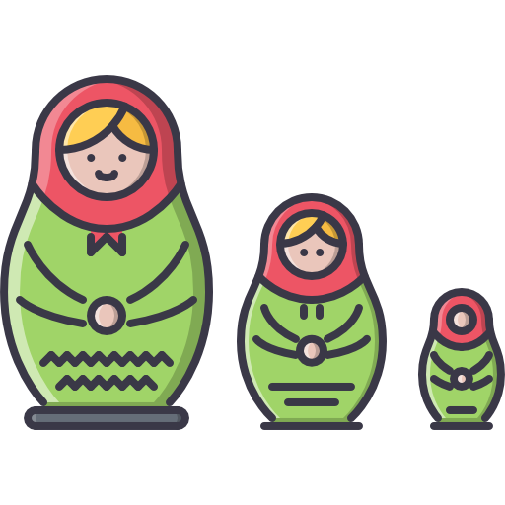
What is Recursion?
Recursion: an approach to solving a problem by solving smaller instances of the same problem
A recursive function is a function that calls itself, and returns the eventual result it receives from the successive function calls
Successive executions are added to the execution stack
A base case is the smallest problem whose answer we know
Once base case is reached, we can return its solution, which can be used to produce the solutions of the previous calls, all the way up until we get a final solution for the original problem
Notes:
Matryoshka icon made by Nikita Golubev from flaticon.com

Slide 20
Recursion Visual
Base case
INPUT
OUTPUT
Think of each rectangle as a method call

Slide 21
Recursion Example: Fibonacci Sequence
The Fibonacci sequence is a series of numbers that starts “0, 1, …” and every subsequent number is the sum of the prior two. (0, 1, 1, 2, 3, 5, 8, 13, 21…)
Goal: Calculate the value in the nth index of the Fibonacci sequence.
Base cases are first two numbers in the sequence where the index matches the value
Base case:
n === 0 because its value is also 0
Base case: n === 1 -> 1
Otherwise: fib(n-2)+fib(n-1)

Slide 22
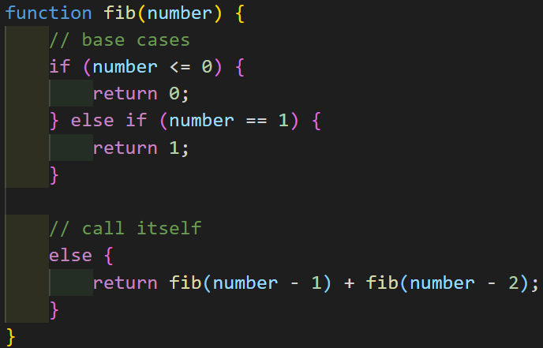
Fib(4)
3
Fib(4)
2
1
Fib(3)
Fib(2)
1
1
1
0
Fib(2)
Fib(1)
Fib(1)
Fib(0)
1
0
Fib(1)
Fib(0)

Slide 23
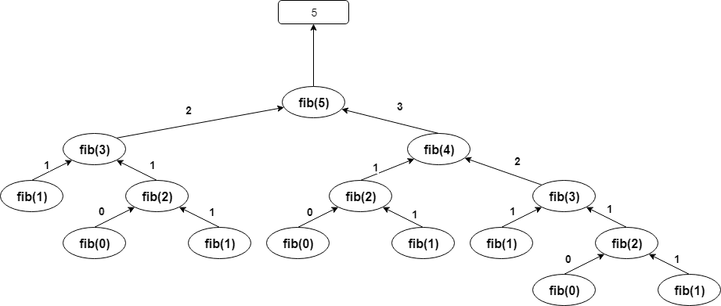
Fib(5)

Slide 24
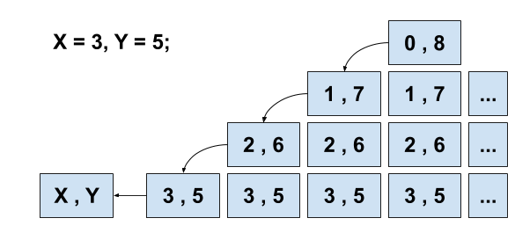
How about something a little simpler…
function peanoAddition(x, y) {
if (x === 0)
return y;
else
return peanoAddition(--x, ++y);
}
Fourth call
Third call
Second call
First call

Slide 25
Why Use Recursion?
Recursion can simplify a number of algorithms once you get used to it.
If an algorithm involves repeated steps, the repetitive part can be isolated recursively.
Is recursion more efficient?
Not really! Most recursive algorithms can also be expressed iteratively (with loops)
So does recursion save memory…?
Not at all! Every recursive invocation of a function places a new copy of that method on the stack.
So why ever use it…?
A recursive approach can make some problems much easier to comprehend and solve.
There are a few circumstances where recursion is virtually mandatory. Compilers use recursion extensively.

Slide 26
Recall
What is scope? Global vs local?
What is a local variable?
What is pass by value?
What is a callback function?
What is an object and what are two ways of creating one?
What is the execution stack?
What is recursion?

